Slide 1
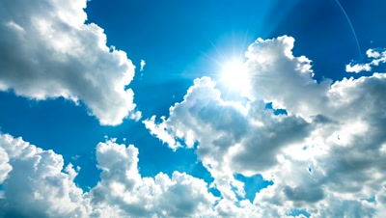
Flood Measurement from a Photo
By
Shaffer, Hoke, Pander & Kuehl Partners LLP

Slide 2




Partners
Clint Hoke
Jamie Shaffer
Jonna Pander
Josh Kuehl

Slide 3

Agenda
Problem Statement
Research
Solution
Issues

Slide 4

Problem: Create a machine model that can detect flood depth from a photo.

Slide 5
Research
Scholarly Articles
Resources
APIs
Libraries
*Full list of research available here

Slide 6







Solution
Latitude and Longitude
Elevation
Local Elevation Flood Prediction
Earth Engine
EXIF
Approximate Flood Depth
Image
Vision AI
True
Depth 4
~ 4 feet
Depth 3
~ 3 feet
AND
VGG16 cNN
Depth 2
~ 2 feet
True
Depth 1
~ 6 inches
Depth 0
No submersion
AND/OR
True
Depth 4
~ 4 feet
Depth 3
~ 3 feet
Depth 2
~ 2 feet
Depth 1
~ 1 foot
Depth 0
No submersion

Slide 7
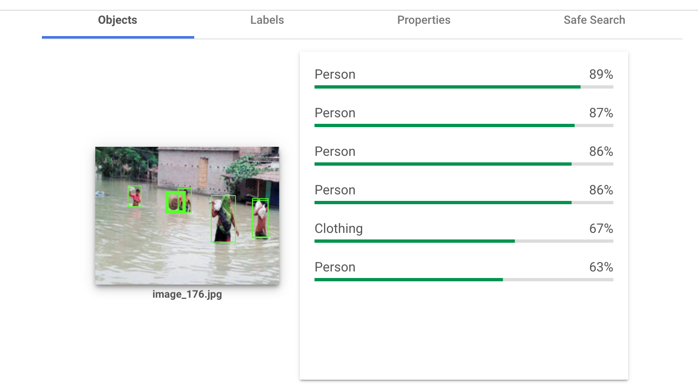
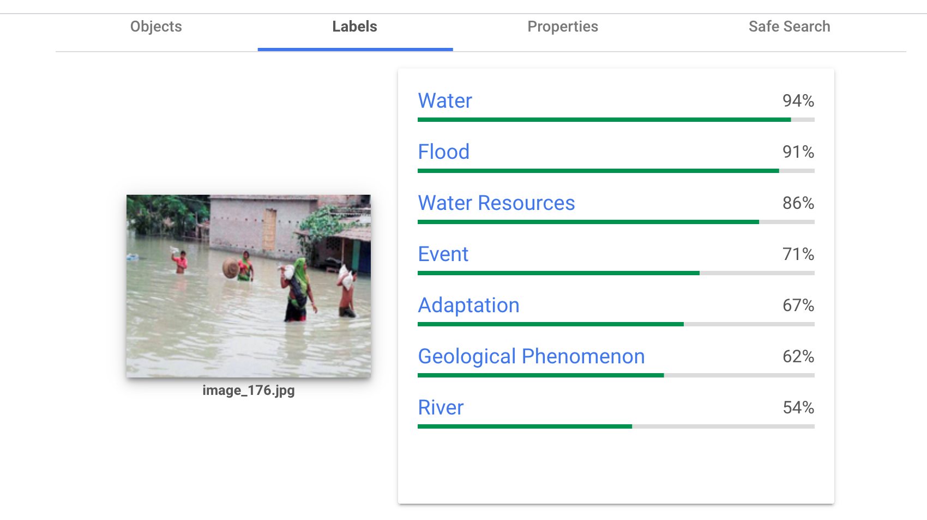
Google Vision AI
Paid Service
Detect objects automatically
Data labeling service
Image pre-processor
API was used to run batches of images

Slide 8
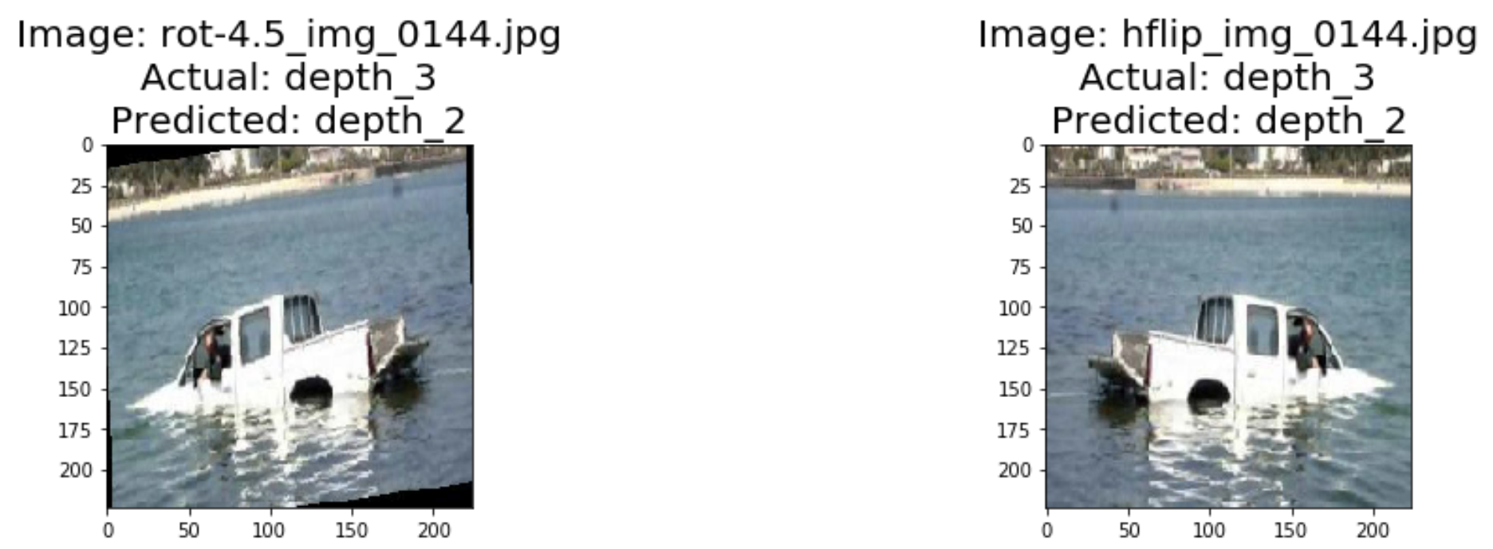
Image Augementation

Slide 9
Results
Truck Model
People Model
Exact Accuracy -32%
Tolerance(+/-1) Accuracy – 80%
Most accurate at depths 0-2
Exact Accuracy -25%
Tolerance(+/-1) Accuracy – 60%
Most accurate at depths 0 and 4

Slide 10
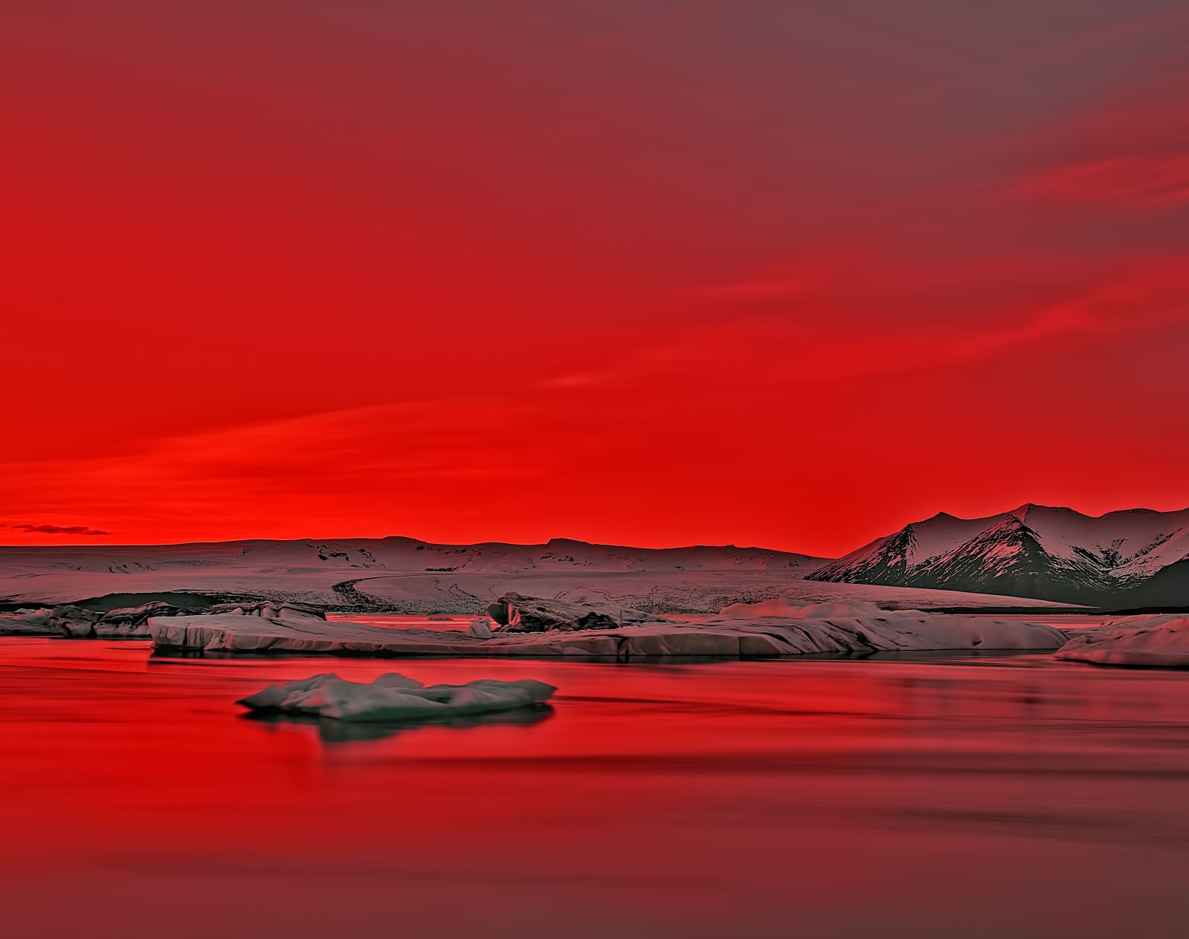
Issues
need more photos
may need to remove complex photos to avoid training issues
shifting images augments the list, but filling with neighbor pixel creates striping
we didn't realize that the ImageDataGenerator would do the crop, so we cropped externally (sorry, Josh!!) and some images have black bars. Unclear if the model is training on this instead of the photo content

Slide 11
Questions

